Slide 1
# Define the window size
window_size = (64, 64)
# Define the step size
step_size = (8, 8)
# Define how many steps to take in x and y directions
x_steps = np.arange(0, image.shape[1] - window_size[1], step_size[0])
y_steps = np.arange(0, image.shape[0] - window_size[0], step_size[1])
8
image.shape[1] - window_size[1]
64
64
height
== image.shape[0]
width==image.shape[1]

Slide 2
def compute_iou(boxA, boxB):
xA = max(boxA[0], boxB[0]) # xA = 200
yA = max(boxA[1], boxB[1]) # yA = 200
xB = min(boxA[2], boxB[2]) # xB = 300
yB = min(boxA[3], boxB[3]) # yB = 300
interArea = max(0, xB - xA + 1) * max(0, yB - yA + 1)
boxAArea = (boxA[2] - boxA[0] + 1) * (boxA[3] - boxA[1] + 1)
boxBArea = (boxB[2] - boxB[0] + 1) * (boxB[3] - boxB[1] + 1)
iou = interArea / float(boxAArea + boxBArea - interArea)
return iou
(100,100)
boxA
(200,200)
boxB
(300,300)
(400,400)

Slide 3
def compute_iou(boxA, boxB):
xA = max(boxA[0], boxB[0]) # xA = 200
yA = max(boxA[1], boxB[1]) # yA = 200
xB = min(boxA[2], boxB[2]) # xB = 200
yB = min(boxA[3], boxB[3]) # yB = 200
interArea = max(0, xB - xA + 1) * max(0, yB - yA + 1)
boxAArea = (boxA[2] - boxA[0] + 1) * (boxA[3] - boxA[1] + 1)
boxBArea = (boxB[2] - boxB[0] + 1) * (boxB[3] - boxB[1] + 1)
iou = interArea / float(boxAArea + boxBArea - interArea)
return iou
(0,0)
boxB
(200,200)
iou = 0.0000123...
boxA
(400,400)

Slide 4
def compute_iou(boxA, boxB):
xA = max(boxA[0], boxB[0]) # xA = 200
yA = max(boxA[1], boxB[1]) # yA = 200
xB = min(boxA[2], boxB[2]) # xB = 200
yB = min(boxA[3], boxB[3]) # yB = 200
interArea = max(0, xB - xA + 1) * max(0, yB - yA + 1)
boxAArea = (boxA[2] - boxA[0] + 1) * (boxA[3] - boxA[1] + 1)
boxBArea = (boxB[2] - boxB[0] + 1) * (boxB[3] - boxB[1] + 1)
iou = interArea / float(boxAArea + boxBArea - interArea)
return iou
(0,0)
boxB
(200,200)
iou = 0.0000123...
boxA
(400,400)

Slide 5
def non_max_suppression(boxes, probs=None, overlapThresh=0.3):
if len(boxes) == 0:
return []
if boxes.dtype.kind == "i":
boxes = boxes.astype("float")
pick = []
x1 = boxes[:, 0] # [100,100,100,1000,1000]
y1 = boxes[:, 1] # [200,200,200,100,100]
x2 = boxes[:, 2] # [350,400,300,1150,1200]
y2 = boxes[:, 3] # [300,500,800,600,700]
area = (x2 - x1 + 1) * (y2 - y1 + 1)
idxs = probs
idxs = np.argsort(idxs)
boxes=np.array([
[100,200,350,300],
[100,200,400,500],
[100,200,300,800],
[1000,100,1150,600],
[1000,100,1200,700]
])
probs = np.array([0.6,0.7,0.9,0.7,0.8])
0.6 0.7 0.7 0.8 0.9
0 1 3 4 2
(1000,100)
(100,200)
0.7
0.6
(350,300)
0.7
(400,500)
(1150,600)
[ 100. 100. 100. 1000. 1000.]
[200. 200. 200. 100. 100.]
[ 350. 400. 300. 1150. 1200.]
[300. 500. 800. 600. 700.]
0.8
0.9
(1200,700)
(300,800)
(251,101)

Slide 6
while len(idxs) > 0:
last = len(idxs) - 1
i = idxs[last]
pick.append(i)
print(x1[i]) # 100
ptint(x1[idxs[:last]]) # [100,100,1000,1000]
xx1 = np.maximum(x1[i], x1[idxs[:last]])
# [100,100,100,100] [100,100,1000,1000]
# print(xx1) # [100,100,1000,1000]
yy1 = np.maximum(y1[i], y1[idxs[:last]])
# print(yy1) # [200,200,200,200]
xx2 = np.minimum(x2[i], x2[idxs[:last]])
# print(xx2) # [300,300,300,300]
yy2 = np.minimum(y2[i], y2[idxs[:last]])
# print(yy2) # [300,500,600,700]
w = np.maximum(0, xx2 - xx1 + 1)
print(w) # [0,0,0,0] [201,201,-699,-699] => [201,201,0,0]
h = np.maximum(0, yy2 - yy1 + 1)
print(w) # [0,0,0,0] [101,301,401,501] => [101,301,401,501]
print(area[idxs[:last]]) # [251*101,301*301,151*501,201*601]
overlap = (w * h) / area[idxs[:last]]
print(overlap) # [20301,60501,0,0] / [251*101,301*301,151*501,201*601]
# [0.80,0.67,0,0]
print(np.where(overlap > overlapThresh)[0]) # [0,1]
print(np.concatenate(([last],np.where(overlap > overlapThresh)[0]))
# [4,0,1]
idxs = np.delete(idxs, np.concatenate(([last],
np.where(overlap > overlapThresh)[0])))
return pick
boxes=np.array([
[100,200,350,300],
[100,200,400,500],
[100,200,300,800],
[1000,100,1150,600],
[1000,100,1200,700]
])
probs = np.array([0.6,0.7,0.9,0.7,0.8])
0.6 0.7 0.7 0.8 0.9
0 1 3 4 2
(1000,100)
(100,200)
0.7
0.6
(350,300)
0.7
(400,500)
(1150,600)
0.8
0.9
(1200,700)
(300,800)
last
last
idxs
0
1
3
4
2
idxs
3
4
pick
2
pick
2
4

Slide 7
DT=(0.657031, 0.653125, 0.648438, 0.552083)
# box : (centerX, centerY, width, height)
def convertToAbsoluteValues(size, box):
xIn = round(((2 * float(box[0]) - float(box[2])) * size[0] / 2))
yIn = round(((2 * float(box[1]) - float(box[3])) * size[1] / 2))
xEnd = xIn + round(float(box[2]) * size[0])
yEnd = yIn + round(float(box[3]) * size[1])
if xIn < 0:
xIn = 0
if yIn < 0:
yIn = 0
if xEnd >= size[0]:
xEnd = size[0] - 1
if yEnd >= size[1]:
yEnd = size[1] - 1
return (xIn, yIn, xEnd, yEnd)
GT=(0.572656, 0.523958, 0.698438, 0.589583)
size=(640,480)
640
(143,110)
w=0.698438
h=0.589583
(0.572656,0.523958)
480
(590,393)

Slide 8
def AP(detections, groundtruths, classes, IOUThreshold = 0.3, method = 'AP'):
result = []
for c in classes:
dects = [d for d in detections if d[1] == c]
gts = [g for g in groundtruths if g[1] == c]
dects = sorted(dects, key = lambda conf : conf[2], reverse=True)
TP = np.zeros(len(dects))
FP = np.zeros(len(dects))
det = Counter(cc[0] for cc in gts)
for key, val in det.items():
det[key] = np.zeros(val)
dects
[['363', 0.0, 0.92, (280, 69, 696, 435)],
['297', 0.0, 0.77, (499, 286, 791, 455)],
['297', 0.0, 0.33, (138, 173, 335, 330)]]
dects
TP
[['297', 0.0, 0.33, (138, 173, 335, 330)],
['297', 0.0, 0.77, (499, 286, 791, 455)],
['363', 0.0, 0.92, (280, 69, 696, 435)]]
0
0
'297'
0
0
0
'363'
0
FP
'299'
0
0
0
0

Slide 9
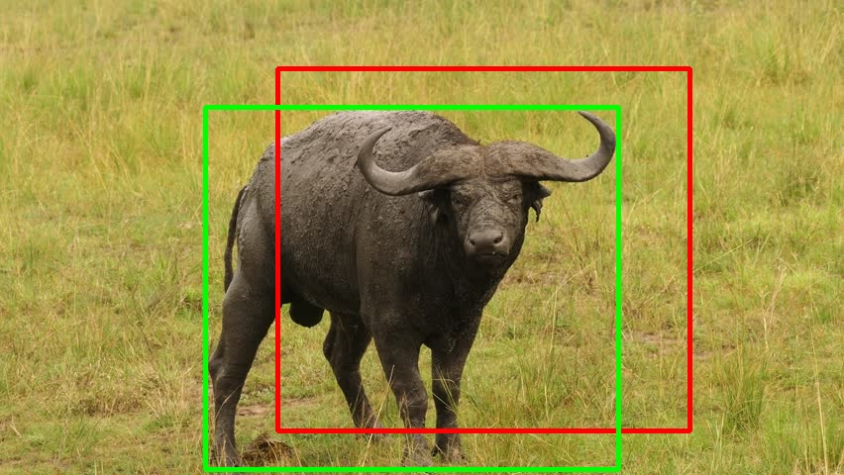
for d in range(len(dects)):
gt = [gt for gt in gts if gt[0] == dects[d][0]]
iouMax = 0
for j in range(len(gt)):
iou1 = iou(dects[d][3], gt[j][3])
if iou1 > iouMax:
iouMax = iou1
jmax = j
if iouMax >= IOUThreshold:
if det[dects[d][0]][jmax] == 0:
TP[d] = 1
det[dects[d][0]][jmax] = 1
else:
FP[d] = 1
else:
FP[d] = 1
dects
[['363', 0.0, 0.92, (280, 69, 696, 435)],
['297', 0.0, 0.77, (499, 286, 791, 455)],
['297', 0.0, 0.33, (138, 173, 335, 330)]]
gts
[['297', 0.0, 1.0, (106, 195, 303, 352)],
['297', 0.0, 1.0, (548, 250, 841, 419)],
['363', 0.0, 1.0, (207, 108, 624, 474)],
['299', 0.0, 1.0, (434, 223, 715, 386)]]
gt
[['363', 0.0, 1.0, (207, 108, 624, 474)]]
d
363
det
TP
iouMax
jmax
0
0
'297'
1
0
0
0.59
0
'363'
1
FP
'299'
0
0
0
0

Slide 10
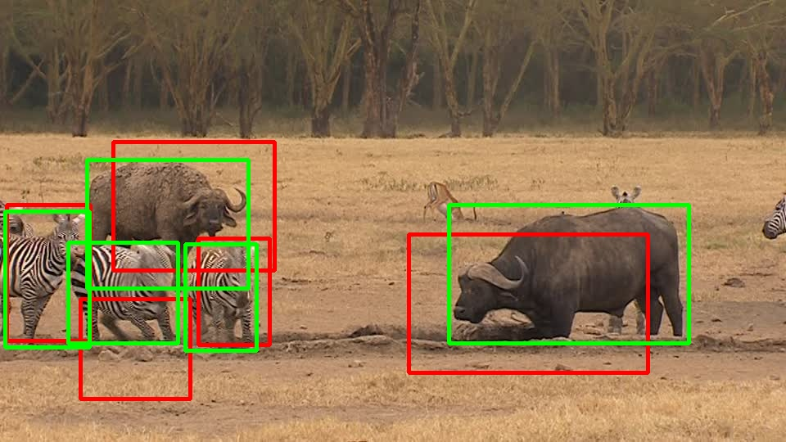
for d in range(len(dects)):
gt = [gt for gt in gts if gt[0] == dects[d][0]]
iouMax = 0
for j in range(len(gt)):
iou1 = iou(dects[d][3], gt[j][3])
if iou1 > iouMax:
iouMax = iou1
jmax = j
if iouMax >= IOUThreshold:
if det[dects[d][0]][jmax] == 0:
TP[d] = 1
det[dects[d][0]][jmax] = 1
else:
FP[d] = 1
else:
FP[d] = 1
dects
[['363', 0.0, 0.92, (280, 69, 696, 435)],
['297', 0.0, 0.77, (499, 286, 791, 455)],
['297', 0.0, 0.33, (138, 173, 335, 330)]]
gts
[['297', 0.0, 1.0, (106, 195, 303, 352)],
['297', 0.0, 1.0, (548, 250, 841, 419)],
['363', 0.0, 1.0, (207, 108, 624, 474)],
['299', 0.0, 1.0, (434, 223, 715, 386)]]
gt
[['297', 0.0, 1.0, (106, 195, 303, 352)],
['297', 0.0, 1.0, (548, 250, 841, 419)]]
d
297
det
TP
iouMax
jmax
1
1
'297'
1
1
1
0.56
0
'363'
1
FP
'299'
0
0
0
0

Slide 11
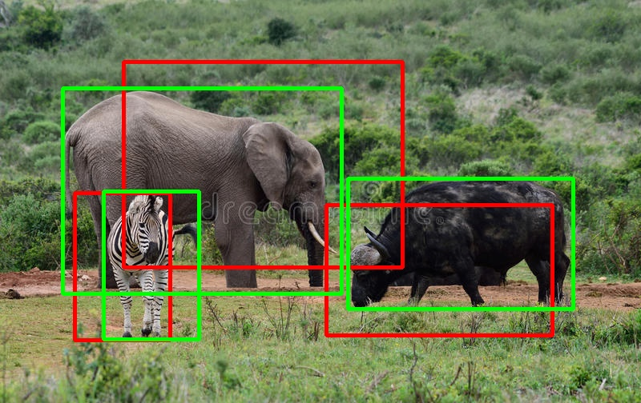
acc_FP = np.cumsum(FP)
acc_TP = np.cumsum(TP)
rec = acc_TP / npos
prec = np.divide(acc_TP, (acc_FP + acc_TP))
dects
[['363', 0.0, 0.92, (280, 69, 696, 435)],
['297', 0.0, 0.77, (499, 286, 791, 455)],
['297', 0.0, 0.33, (138, 173, 335, 330)]]
acc_FP
acc_TP
rec
prec
gts
0
0
0
1
2
3
0.25
0.50
0.75
1.0
1.0
1.0
[['297', 0.0, 1.0, (106, 195, 303, 352)],
['297', 0.0, 1.0, (548, 250, 841, 419)],
['363', 0.0, 1.0, (207, 108, 624, 474)],
['299', 0.0, 1.0, (434, 223, 715, 386)]]
d
det
TP
npos
1
1
gt
'297'
1
1
1
4
'363'
[['297', 0.0, 1.0, (106, 195, 303, 352)],
['297', 0.0, 1.0, (548, 250, 841, 419)]]
1
FP
'299'
0
0
0
0
363
297
299

Slide 12
def calculateAveragePrecision(rec, prec):
mrec = [0] + [e for e in rec] + [1]
mpre = [0] + [e for e in prec] + [0]
for i in range(len(mpre)-1, 0, -1):
mpre[i-1] = max(mpre[i-1], mpre[i])
ii = []
for i in range(len(mrec)-1):
if mrec[1:][i] != mrec[0:-1][i]:
ii.append(i+1)
ap = 0
for i in ii:
ap = ap + np.sum((mrec[i] - mrec[i-1]) * mpre[i])
return [ap, mpre[0:len(mpre)-1], mrec[0:len(mpre)-1], ii]
rec
prec
0.25
0.50
0.75
1.0
1.0
1.0
mrec
0.0
0.25
0.50
0.75
1.0
mpre
1.0
1.0
1.0
1.0
0.0
0.25
0.50
0.75
0.75
0.0
0.25
0.50
0.75
ii
1
2
3
4
ap
0.75
363
297
299

Slide 13
Selective search 알고리즘을 통해 객체가 있을 법할 위치인 후보 영역(region proposal)을 2000개 추출하여, 각각을 227x227 크기로 warp시켜줍니다.
Warp된 모든 region proposal을 Fine tune된 AlexNet에 입력하여 2000x4096 크기의 feature vector를 추출합니다.
추출된 feature vector를 linear SVM 모델과 Bounding box regressor 모델에 입력하여 각각 confidence score와 조정된 bounding box 좌표를 얻습니다.
마지막으로 Non maximum suppression 알고리즘을 적용하여 최소한의, 최적의 bounding box를 출력합니다.

Slide 15
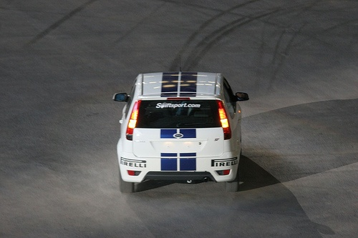
1. Fine tuning pre-trained AlexNet
Positive samples
370*1400
32
crop, resize 됨
warp
IOU>0.5
PASCAL
VOC
...
(128,227,227)
(128,2)
Pre-trained
AlexNet
96
한개의 이미지
최대 2000개
region
IOU<0.5
Mini batches(128)
Negative samples

Slide 16
2. Training linear SVM using fine tuned AlexNet
Positive samples
Groud truth
(128,2)
PASCAL
VOC
...
(128,227,227)
(128,4096)
Fine-tuned
AlexNet
Linear
SVM
한개의 이미지
최대 2000개
region
IOU<0.3
Mini batches(128)
Negative samples
Hard negative Mining

Slide 17
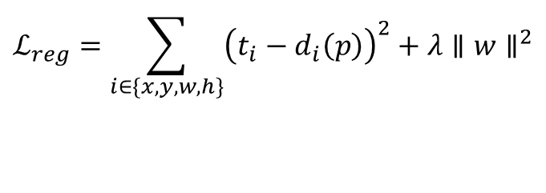
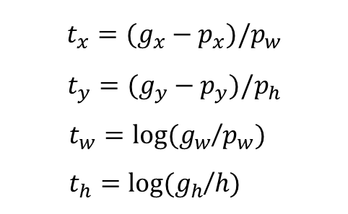
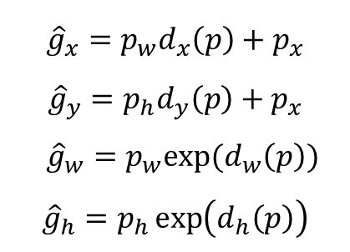
SS Predicted
수정 예측 값
Target
$${\hat{g}}_{x}=p_{w}d_{x}\left(p\right)+p_{x}$$
$${\hat{g}}_{y}=p_{h}d_{y}\left(p\right)+p_{x}$$
${\hat{g}}_{w}=p_{w}exp⁡(d_{w}\left(p\right))$
$${\hat{g}}_{h}=p_{h}\exp\left(d_{h}\left(p\right)\right)$$
Ground Truth
$$t_{x}=(g_{x}−p_{x})/p_{w}$$
$$t_{y}=(g_{y}−p_{y})/p_{h}$$
$t_{w}=log⁡(g_{w}$/$p_{w})$
$t_{h}=log⁡(g_{h}$/$h)$
손실 함수
SSE(Sum of Squared Error)
$$ℒ_{reg}=\sum_{i∈\{x,y,w,h\}}{{\left(t_{i}−d_{i}\left(p\right)\right)}^{2}+λ∥w∥^{2}}$$

Slide 18
3. Training Bounding box regressor using fine tuned AlexNet
Positive samples
(128,4)
PASCAL
VOC
(128,227,227)
(128,4096)
Bounding
Box
Regressor
IOU>0.6
Fine-tuned
AlexNet
한개의 이미지
최대 2000개
region
Feature vector

Slide 19
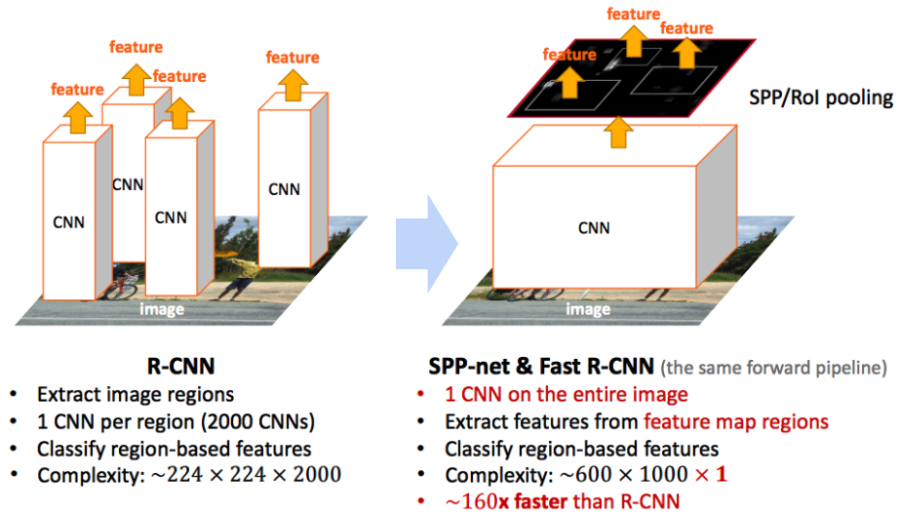
R-CNN vs Fast R-CNN

Slide 20
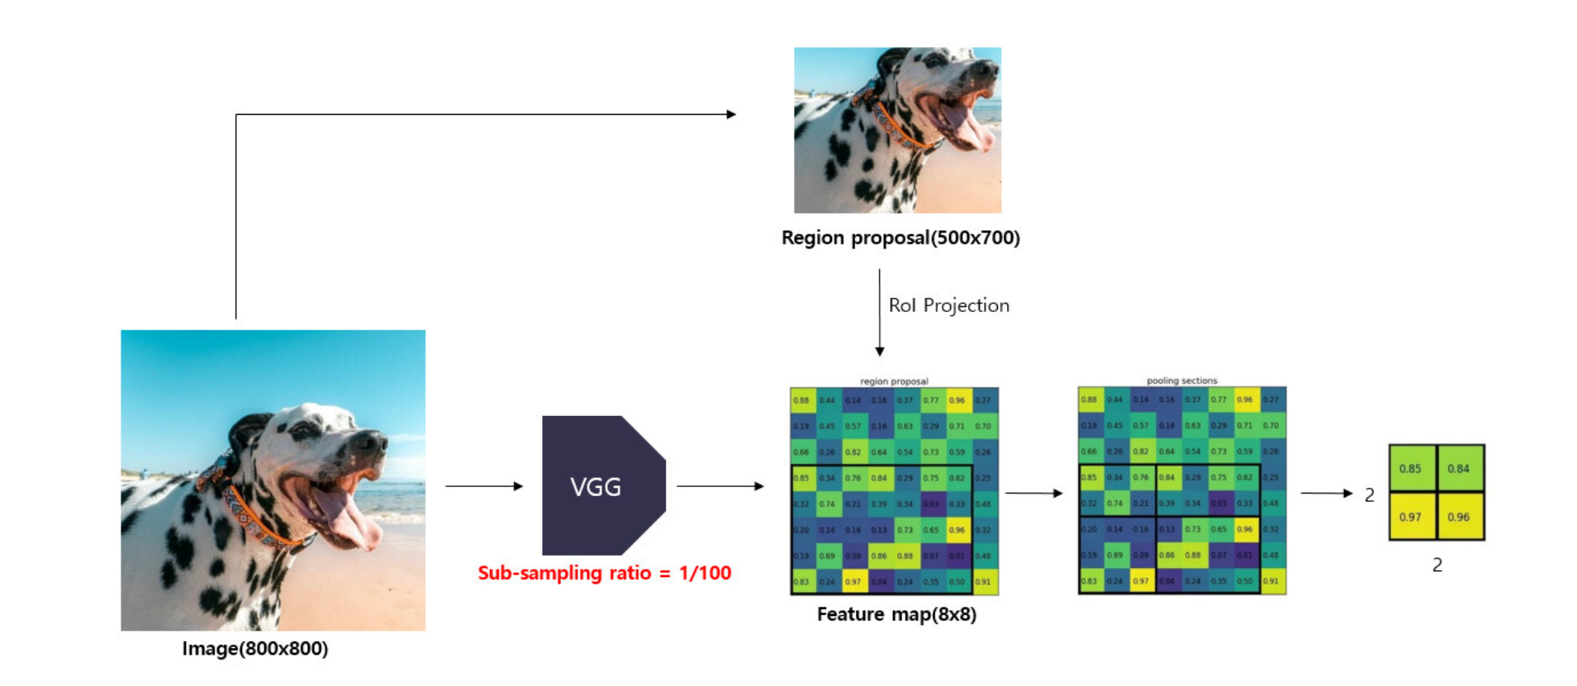
RoI pooling 개념
(0,300)
(0,3)
(700,800)
(7,8)

Slide 21
R-CNN vs Fast R-CNN
K=20
K+1 (백그라운드 포함)
clasifier
((K+1)*1,)
최대 2000개
region
Truncated SVD
PASCAL
VOC
Pre-trained
VGG
(224,224,3)
(14,14,512)
(7,7,512)
Multi-task
loss
(25088)
한개의 이미지
RoI
pooling
((K+1)*4,)
Feature vector
(4096,)
Bounding box
regressor

Slide 22
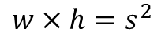
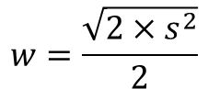
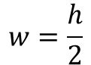
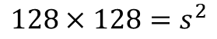
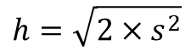
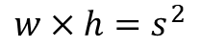
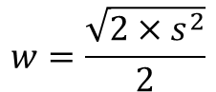
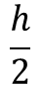
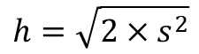
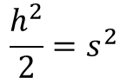
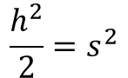
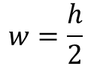
[1:1, 1:2, 2:1]
$$w×h=s^{2}$$
(128,128)
$$\frac{h}{2}$$
$$w=\frac{h}{2}$$
128
91
181
$$\frac{h^{2}}{2}=s^{2}$$
128
181
91
h
$$h=\sqrt{2×s^{2}}$$
$$w×h=s^{2}$$
$$w=\frac{\sqrt{2×s^{2}}}{2}$$
$$128×128=s^{2}$$
$$w=\frac{h}{2}$$
$$\frac{h^{2}}{2}=s^{2}$$
$$h=\sqrt{2×s^{2}}$$
$$w=\frac{\sqrt{2×s^{2}}}{2}$$

Slide 23
(0): Conv2d(3, 64, kernel_size=(3, 3), stride=(1, 1), padding=(1, 1))
(1): ReLU(inplace=True)
(2): Conv2d(64, 64, kernel_size=(3, 3), stride=(1, 1), padding=(1, 1))
(3): ReLU(inplace=True)
(4): MaxPool2d(kernel_size=2, stride=2, padding=0, dilation=1, ceil_mode=False)
(1,3,800,800) (64,3,3,3) => (1,64,800,800)
(1,64,800,800) (64,64,3,3) => (1,64,800,800)
(N-F+2*P)/S+1=>out
(1,64,800,800) => (1,64,400,400)
(800-3+2*1)/1+1=>800
(800-3+2*1)/1+1=>800

